Slide 1
SIDONPAY
Week 8 Business Intelligence Analysis
Transaction Behaviour • Customer Segmentation • Operations • Fraud Risk
Prepared by: Mary Theophilus | Team Ace
Tools: Python + Power BI

Slide 2
Analytical Approach
From raw transactions to business decisions
Data quality checks → transaction analysis → customer features → behavioural segmentation → fraud diagnostics → operational trends → Power BI → recommendations.
No missing values were found and 0 duplicate rows were found in the Python checks.
Segmentation uses transactional characteristics rather than demographics.

Slide 3
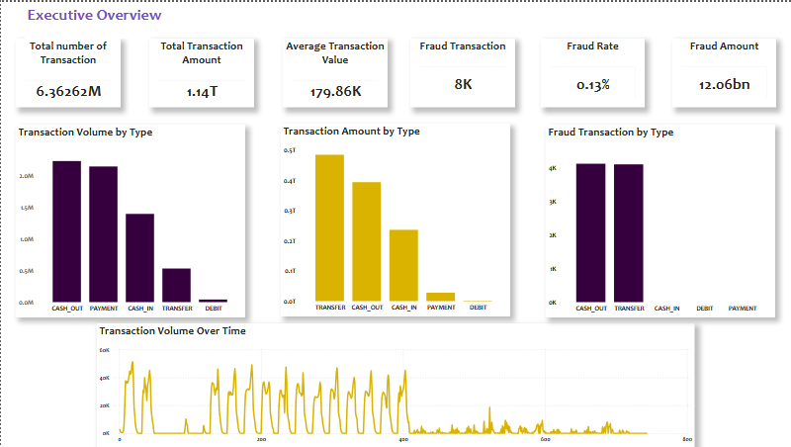
Executive Summary
What the data means for SIDONPAY
6.36M
Transactions
1.14T
Value
0.13%
Fraud Rate
8,213
Fraud Cases
CASH_OUT is the most frequent transaction type.
TRANSFER has the highest total and average transaction value.
Fraud is concentrated in CASH_OUT and TRANSFER.
Existing flagging detects only 0.1948% of observed fraud.

Slide 4
Transaction Behaviour
Volume and value tell different stories
CASH_OUT drives transaction volume and therefore operational workload.
TRANSFER drives transaction value and average transaction size.
Transaction activity varies over time; peak analysis supports capacity and monitoring planning.

Slide 5
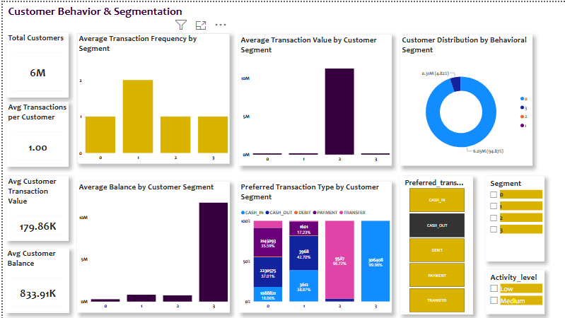
Customer Behaviour & Segmentation
Four behavioural segments identified
94.87%
Average Frequency
2.0
Highest Average Frequency
11.31M
Average Transaction Amount
11.72M
Average Customer Balance
Segment 0: 94.87% of customers; average frequency 1.0 → activation opportunity.
Segment 1: highest average frequency at 2.0 → retention opportunity.
Segment 2: average transaction amount 11.31M → high-value monitoring opportunity.
Segment 3: average balance 11.72M → balance-management and engagement opportunity.

Slide 6
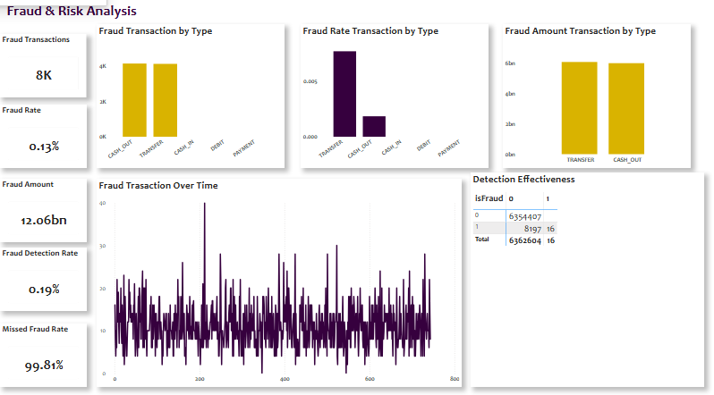
Fraud Detection Effectiveness
The largest control gap
16
True Positives
8,197
False Negatives
0.1948%
Recall
99.8052%
Missed Fraud
True positives: 16 | False negatives: 8,197.
Recall/detection rate: 0.1948%.
Missed fraud rate: 99.8052%.
Precision: 100%; false-positive rate: 0%.
Conclusion: the current flagging mechanism cannot be the standalone fraud-control approach.

Slide 7
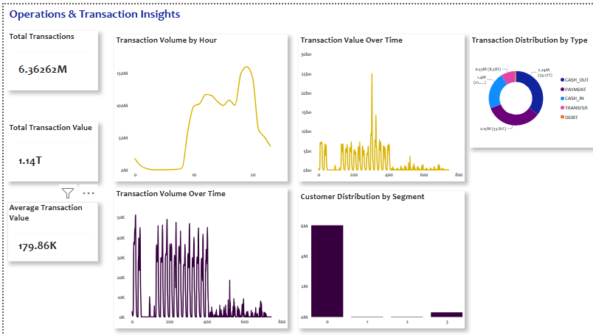
Operations & Capacity
Preparing SIDONPAY for scale
Monitor transaction volume by hour and over time.
Plan processing capacity around high-volume CASH_OUT activity.
Separate workload planning from financial-value planning because volume and value tell different stories.
Align monitoring and support resources with peak activity.

Slide 8
Strategic Recommendations
Actions before SIDONPAY launch
Risk: prioritize TRANSFER/CASH_OUT and add behavioural + sequence signals.
Product: optimize high-volume cash-out and high-value transfer journeys.
Marketing: activate low-activity customers and retain engaged users.
Operations: plan capacity around transaction peaks.
Data/Engineering: continuously monitor detection performance.

Slide 9
Stakeholder Action Plan
Evidence-led decisions
Executive Management → risk investment and launch readiness.
Product → transaction experience and security controls.
Marketing → behavioural activation and retention.
Risk → multi-factor monitoring and graduated controls.
Operations → capacity planning.
Data/Engineering → behavioural and sequence detection.

Slide 10
Decision Summary
What SIDONPAY should take forward
Large transaction environment with distinct volume, value and risk patterns.
Customer segmentation reveals activation, retention and high-value opportunities.
TRANSFER and CASH_OUT should shape fraud-monitoring priorities.
0.1948% recall demonstrates the need for broader risk monitoring.
Recommended direction: behavioural intelligence + risk-based controls + operational readiness.

